Slide 1



Rehab@Home
- Remote physiotherapy monitoring for rehabilitation -
This demo shows an exercise session for patients in rehabilitation after shoulder, hip or knee surgery by using the Kinect sensor device and Kinect for Windows SDK (C#).
Natalia Díaz Rodríguez, Frank Wickström, Johan Lilius
Turku Centre for Computer Science (TUCS),
Dept. of Information Technologies, Åbo Akademi University, Turku, Finland
Marion Karppi
Turku School of Applied Science, Well-being Services
Olmo León, M.P. Cuéllar & Miguel Delgado Calvo-Flores
Dept. of Computer Science and Artificial Intelligence, University of Granada, Spain
August 2013

Slide 2
User interface
Allows recording new patterns from new users realizing exercises for the system to learn to recognize them:
Record and Replay: Records a session for training the system. Audio option activates and ends recording via voice (“Record”, “Stop”)
Stabilities: Indicates the degree of stability of the skeleton tracked.
Capture and Delete Gesture: Adds (and deletes) a template gesture to a gesture learning model.
Capture T: adds a template posture to a posture learning model.
View Depth/View color: Shows depth/color image
Exercises to be trained &recognized:
In FRONT position with the camera:
Left and RightHipAbduction
Left and RightKneeExtension
In PROFILE position with the camera:
Left and RightHipExtension
Sit and Stand

Slide 3
Background
The context of our project falls within one of today’s key problems in society: the ageing of the population.
New technological solutions are needed to allow more independent living, at the same time as easier and more accessible healthcare and wellbeing.
Our project supports this paradigm not only providing a general physiotherapy and rehabilitation remote solution for home but also, in the future, other use case scenarios, such as human activity recognition in different Smart Spaces (home, office, hospital, etc.).
The business opportunities for our framework are multiple and versatile: in health-care (for care-takers, at home) in industry processes or in any Smart Space for remote monitoring. We consider commercialization after development.

Slide 4
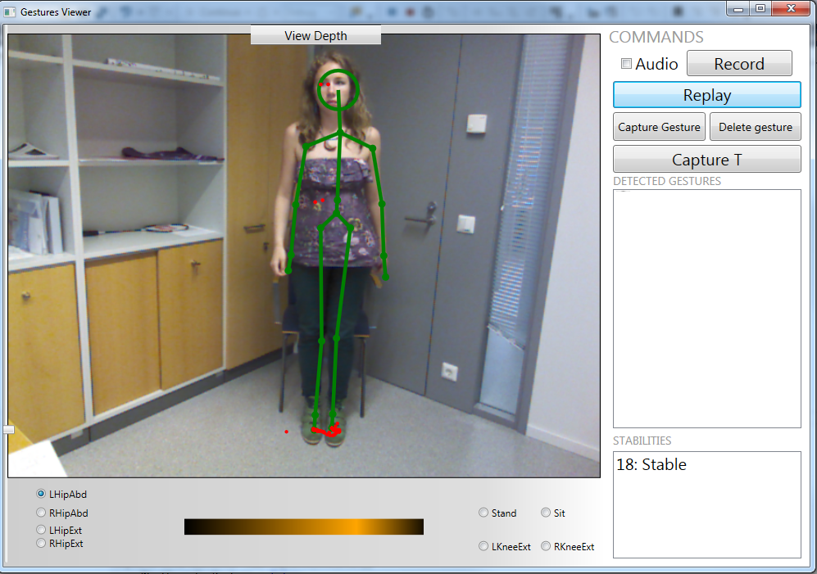

Slide 5
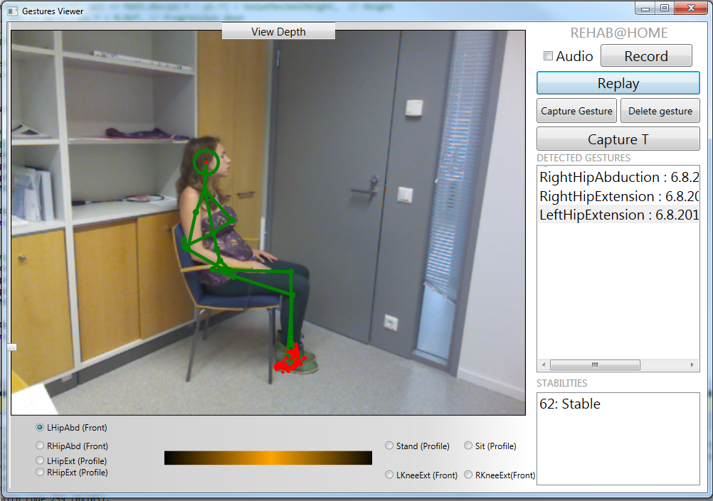

Slide 6
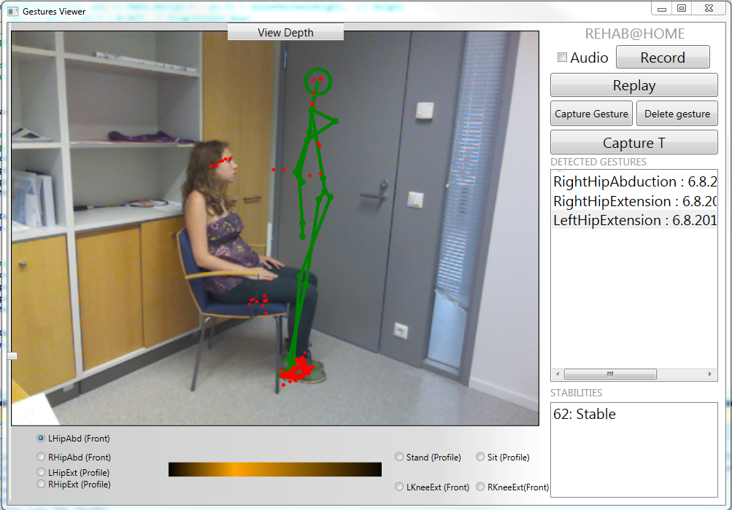

Slide 7
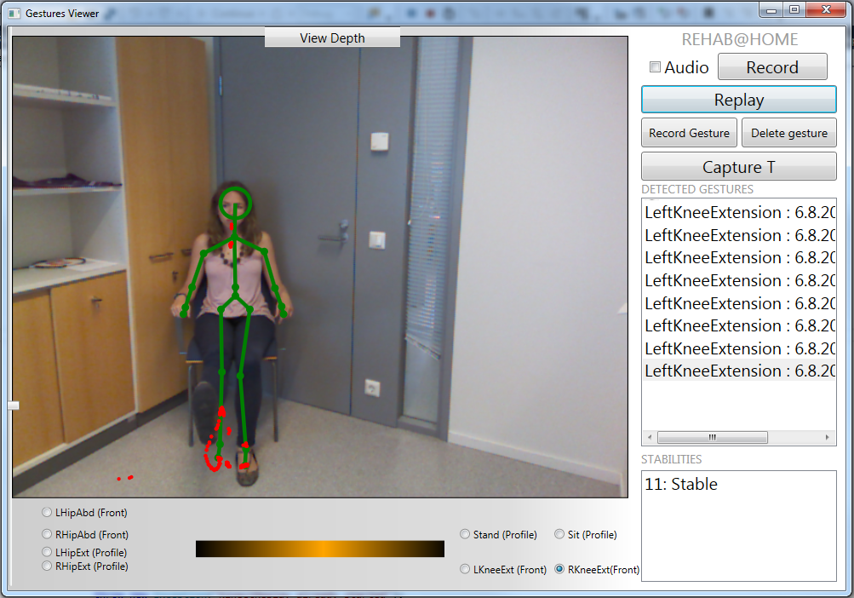

Slide 8
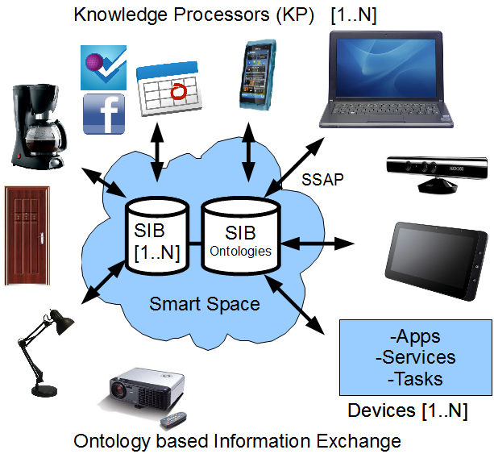
Future Directions
Integration with semantic Smart Space Architecture
Eg. To obtain long-term evolution/changes
Extension of exercises and precision.

Slide 9
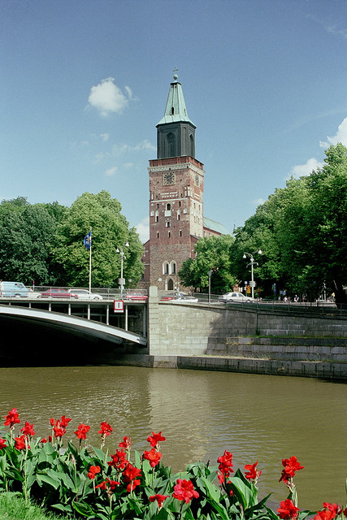

More information:
Natalia Díaz Rodríguez
ndiaz@abo.fi
Embedded Systems Lab. Department of Information Technologies
Åbo Akademi University, Turku, Finland
TUCS (Turku Centre for Computer Science)
Department of Computer Science and Artificial Intelligence
University of Granada, Spain

